Slide 1
Chronic Kidney Disease Analysis
Team – 5
Gaurav Soni
Pramod Poojar
Surendra K V
Abhishek B P

Slide 2
Introduction
Chronic Kidney Disease (CKD) is a major medical problem and can be cured if treated it in the early stages. People usually go to medical centres to get a test for existence of this disease in their body. But this usually takes a lot of time and money. Usually people are not aware that medical tests which are done for different purposes might contain some valuable information which can help them determine kidney disease. The technology of machines learning can help to a large extent to smoothen the process of Chronic Kidney Disease detection and help patients to take quick measures so that it can be cured in early stages.

Slide 3
Project Overview
In this project, we have analysed a real dataset which comes from the hospitals in India containing information about general medical tests of around 400 patients. The analysis of the dataset has resulted in a Machine Learning classification model which is trained on this dataset and predicts the presence of Chronic Kidney Disease in a patients body with a high accuracy. The model works on the Decision Tree Classification Algorithm to classify whether the patients has Chronic Kidney Disease or not. Also, there is a user-friendly interface created as a part of this project which enables the end-users to use this model and get the results very quickly saving their time and money. Ultimately, it can help patients to take quick actions for curing this deadly disease in its early stages.

Slide 4
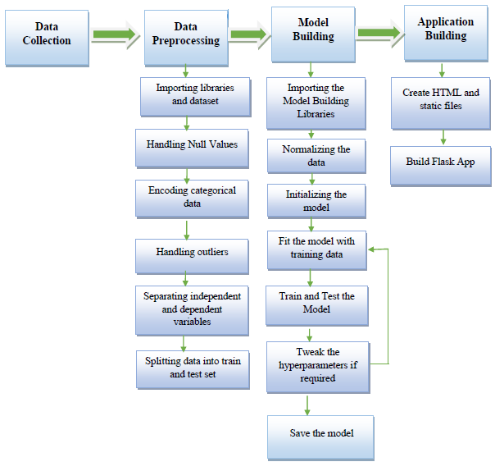
Block Diagram
Fig: Block Diagram

Slide 5
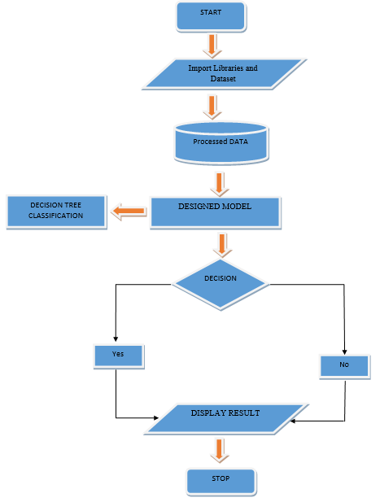
Fig: Flow Chart

Slide 6
Data Collection
Data has been collected from a Kaggle repository. The data was taken over a 2-month period in India with 25 features ( eg, red blood cell count, white blood cell count, etc). The target is the 'classification', which is either 'ckd' or 'notckd' - ckd=chronic kidney disease. There are 400 records in the dataset. Data has a lot of noise which must be cleaned and pre-processed before using it for training and testing the model.

Slide 7
Data Pre-Processing
Dataset contains many null values which are handled using appropriate techniques. Records for columns having less than 5% null values of total dataset and erroneous records are dropped. Other null values are handled by replacing nulls with mean or mode after thorough analysis of dataset using data visualization techniques. Non useful columns are also dropped. Encoding of categorical text variables is done using Label Encoding. Dataset is divided into 80% as train data and 20% as test data. Also, the standardization of dataset is done using Standard Scaler before feeding it to the model.

Slide 8
Model Building
Model is built using the Decision Tree Classification Algorithm. It uses Pipeline from sklearn package to perform operations like data standardization, model initialization, setting up hyperparameters under a single object. The model is then trained using the training data. Its accuracy is improved by testing the model with test data and accordingly tuning the hyperparameters like max_depth of the Decision Tree to further improve the accuracy. Model is evaluated using Confusion Matrix, ROC-AUC Curve, F1 Score which ensures and proves the validity of the model. Finally, the model is saved for using it while application building.

Slide 9
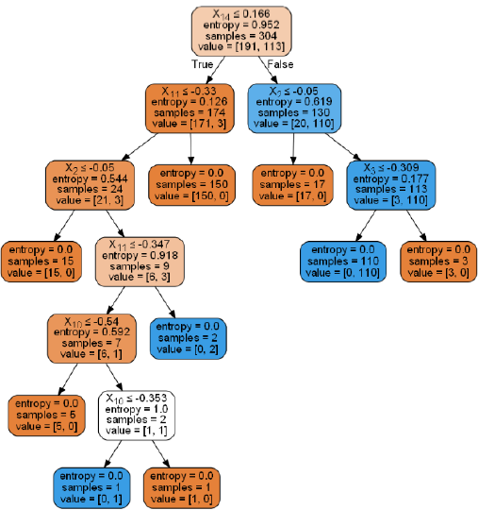
Fig: Decision Tree

Slide 10
Application Building
HTML, CSS and Bootstrap are used to design a user-friendly interface to interact with the model built in last stage. The backend of the application is being handled by Flask framework. The inputs from the user are passed on to the flask back-end through POST request. In backend, this data from user is processed before feeding it to the model. The prediction done by the model is then sent back as a response for the POST request to the frontend. This result is displayed for the user which tells the user whether it’s classified as positive or negative.

Slide 11
Advantages
Decision Tree Classification Algorithm is easy to implement and understand.
It can operate in real-time due to low time complexity.
It is applicable in training and test-time
A Decision trees model is very intuitive and easy to explain to technical teams as well as stakeholders.

Slide 12
Disadvantages
A small change in the data can cause a large change in the structure of the decision tree causing instability.
Decision tree often involves higher time to train the model.

Slide 13
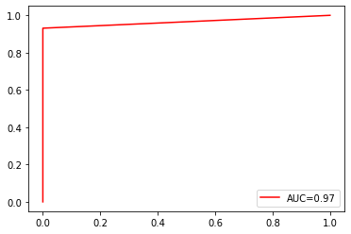
Result
This projects consists of the details about the model which was used for the prediction of CKD using the patients’ data .From the resultant graphs, it is proven that the accuracy of the model has reached 97.4%, if it is deployed in the real-time scenario then it will help many people in diagnosing the CKD without wasting the money on check-up. If the CKD is confirmed by the model, then the person can reach the nearest hospital to get the treatment. It can be the best way of practice for people to save money. As we know that the data plays a crucial role in every machine learning model, if the data is more specific and accurate about the symptoms of the CKD then that can help in reaching greater accuracy with better results in real-time applications.

Slide 14
THANK YOU
Team – 5
Gaurav Soni
Pramod Poojar
Surendra K V
Abhishek B P

